Slide 1

SPM PM Review
G4T4
PM: Tsang Bao Xian
Casper Lim Zhi Xin, Tricia Tan Li Lin, Ong Yan Ning, Loh Xiao Binn

Slide 2

Functionalities
Wiki Question | Answer
Do you plan to drop/add any functionalities? | No
Do you plan to use any PHP frameworks? | No
Did you manage to finish login + 1 functionality? | Yes
What functionalities have you finished? | Login, add bid, bootstrap
What is the IP address & admin password for your cloud deployment? | IP Address: 54.169.210.219 Admin password: @dm1in5PM

Slide 3

Schedule Overview
Weekly Meetings on Tuesdays and Fridays.
Task set on Friday has deadline on Tuesday → 4 Working Days
Task set on Tuesday has deadline on Friday → 3 Working Days

Slide 4
Planned Iterations
Iteration | Task | Start Date | End Date
1 | Login, Add bid, Bootstrap Functionality | Monday of Week 5 | Sunday of Week 6 (end)
2 | Drop bid, Slides for PM review, Web service, Update bid | Monday of Week 7 | Sunday of Week 8
3 | Rounds, Drop section, Dumping | Monday of Week 9 | Sunday of Week 10
4 | Deploying to AWS, UAT, Check UAT results, testing, debugging, redeploy | Monday of Week 11 | Sunday of Week 12
5 | Prepare Final presentation slides | Monday of Week 13 | Sunday of Week 14

Slide 5
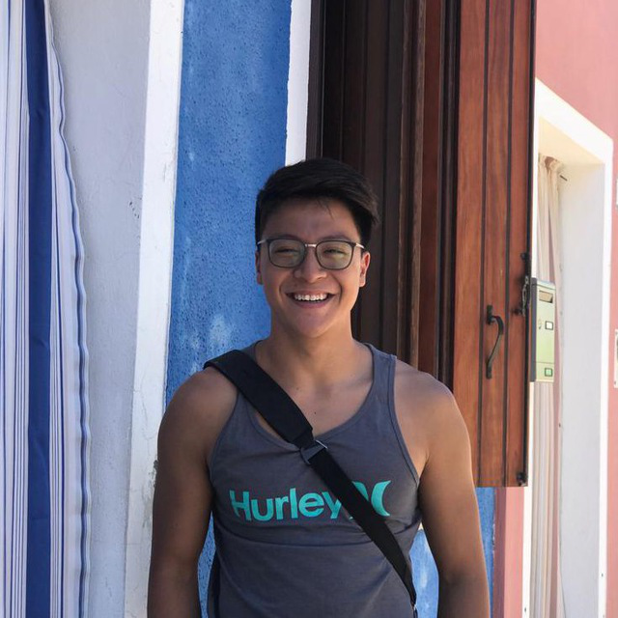
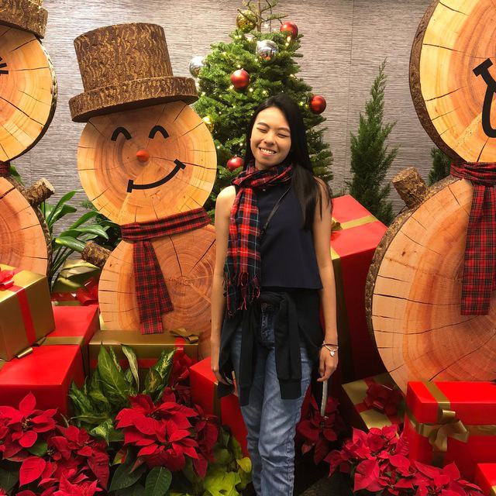
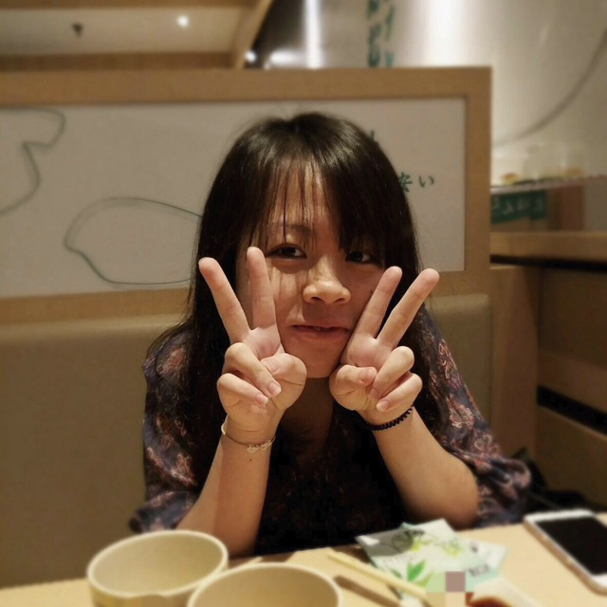
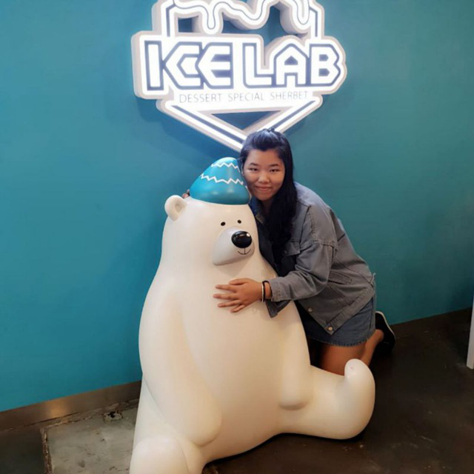

Roles & Task Allocation
d
Bao Xian
PM, Bootstrap validation & Login & Add Bid functionality
Tricia Tan
Login framework & Add Bid functionality & bootstrap debugging
Casper Lim
Bootstrap validation & Login & Add Bid functionality
Loh Xiao Binn
Administrative, bootstrap functionality , test cases
Yan Ning
Administrative, bootstrap framework , test cases

Slide 6
Milestones
27 September – End of Iteration
13 October – PM review
13 September – End of Iteration 2
17 October – Application Demo
27 October – End of Iteration 3
31 October – User Acceptance Test
10 November – End of Iteration 4
17 November – Final submission
21 November – Final Presentation

Slide 7
PM in-charge of Milestone
Milestone | PM
End of Iteration 1 | Bao Xian
PM Review | Tricia
End of Iteration 2 | Tricia
Application Demo | Celine
End of Iteration 3 | Celine
User Acceptance Test | Casper
End of Iteration 4 | Casper
Final Submission | Yan Ning
Final Presentation | Yan Ning

Slide 8
Buffer Time
Deadlines set at next meeting
Taking over/ Helping each other at meetings if any of us face any difficulties
Use Meeting time as buffer to debug

Slide 9
Critical Path (Iteration 1)
Start
Read Wiki
Schedule Iteration 1 tasks
Plan other Iterations
Create Login Page with Welcome Message
Create project database & Complete authentication
Test
Login Page
Test
Iteration 1
Test
Bootstrap
File validations
Add .csv values into database
Create Bootstrap interface
Create addBid page
End

Slide 10

Bug Metrics
Wiki Question | Answer
What is the current value for the metric? | 97
Did you have to take any action according to your mitigation plan? | Yes, debugging session was carried out during group meetings

Slide 11
Roles & Responsibilities
d
Bao Xian
PM, Bootstrap validation & Login & Add Bid functionality
Tricia Tan
Login framework & Add Bid functionality & bootstrap debugging
Casper Lim
Bootstrap validation & Login & Add Bid functionality
Loh Xiao Binn
Administrative, bootstrap functionality , test cases
Yan Ning
Administrative, bootstrap framework , test cases

Slide 12
Paired Programming Rotation Plan
Functionality | Paired Programmer | Paired Programmer
Login Framework | Tricia Tan | Casper Lim
Login Functionality & Validations | Casper Lim | Bao Xian
Add Bid | Bao Xian | Tricia Tan
Bootstrap Framework (1) | Bao Xian | Yan Ning
Bootstrap Framework (2) | Yan Ning | Xiao Binn
Bootstrap Validations & Debugging (1) | Xiao Binn | Casper Lim
Bootstrap Validations & Debugging (2) | Casper Lim | Yan Ning
Bootstrap Validations & Debugging (3) | Yan Ning | Bao Xian
Bootstrap Validations & Debugging (4) | Bao Xian | Tricia Tan

